Slide 1
CEM,IEE,MIS TERM-PROJECT
BATCH-A TEAM-11

Slide 2
TEAM MEMBERS
Vikhyat Bansal
Marreddy Mohit Sasank Reddy
Yarram Sri Sathwik Reddy
Vignesh
[CB.EN.U4AIE21076]
[CB.EN.U4AIE21031]
[CB.EN.U4AIE21077]
[CB.EN.U4AIE21075]

Slide 3
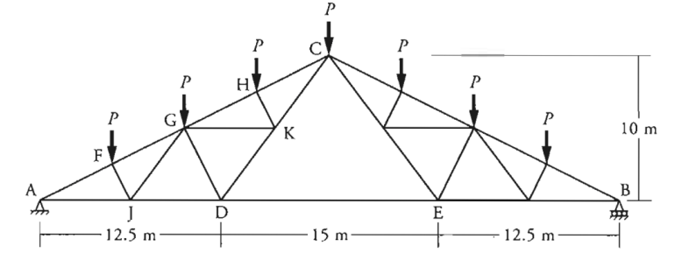
01
Write a computer program to solve the system of linear equations to determine the value of the member forces for the truss shown in the figure for different values of P ranging from 10 kN to 100 kN with an increment of 5 kN.

Slide 4
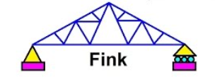
WHAT IS FINK TRUSS?
The Fink truss is a commonly used truss in residential homes and bridge architecture. It originated as a bridge truss although its current use in bridges is rare.
A fink roof truss is traditionally the most commonly used truss type, providing a simple, adaptable and cost efficient roofing solution.
The “fink” is a basic webbed truss design that provides the most economical roof solution.
The web members form a ‘W’ to provide a high strength structure with good load-carrying capacity. The roof load is transmitted entirely to support on the wall plates.
The fink truss can also be used as a support for other trusses by doubling or trebling the number of plies, i.e. in a “hip” roof.
Due to its design flexibility, the fink truss is the most frequently used truss in roof design. Fink truss are usually symmetrical and web design(W) is generally perpendicular to outer triangle sides.

Slide 5
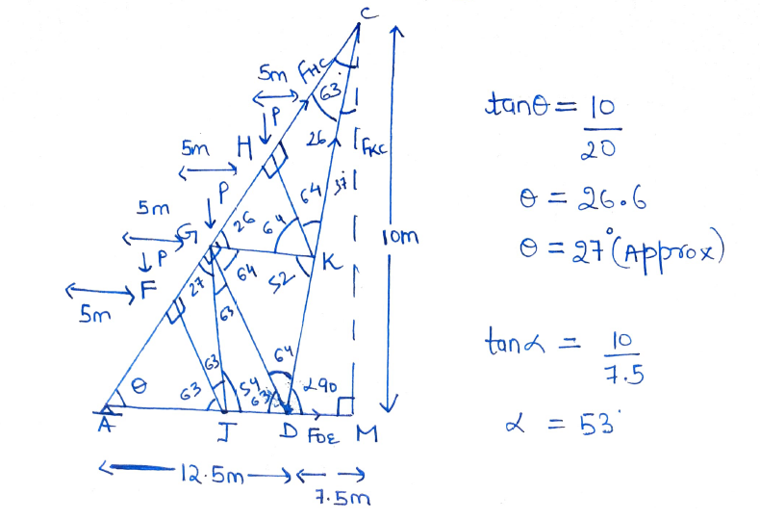
Getting all the angles of truss
From our basic knowledge of geometry we can easily get all the necessary angles required for getting the linear equations.

Slide 6
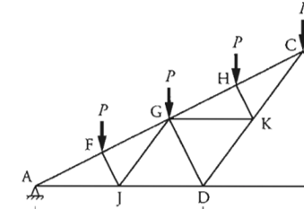
Solution:
We will start solving the fink truss given in question using method of section to get member forces at point A and point C and a force on point D . Method of joints was giving more unknowns than the linear equations and much larger matrices making it difficult to solve that’s why method of section is preferred to use in this Question. We will consider point A and point C as a rigid body and from diagram it can be seen that point A is pin support so now we can write forces acting on point A and point C.
Forces on Point A due to pin support: ∑A_{x} = 0 ∑A_{y} = 0 Member Forces on Point C due to point K, H are F_{HC}, F_{KC} Member Force on Point D which we will calculate using method of section is F_{DE}

Slide 7
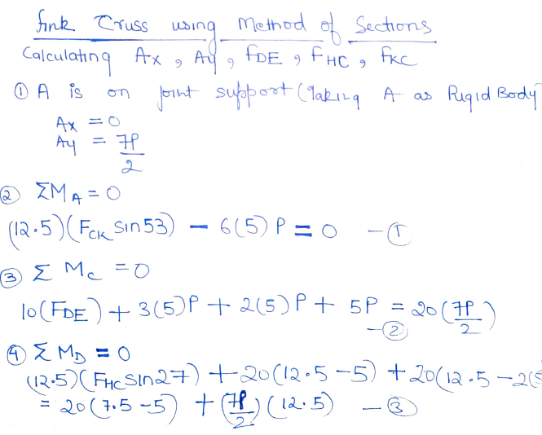
Equations for forces at point A, point C and point D
Now we already know that point A is on pin support where as to get forces at other points, we will take moment about point A,D and C as zero . The equation we get are :

Slide 8
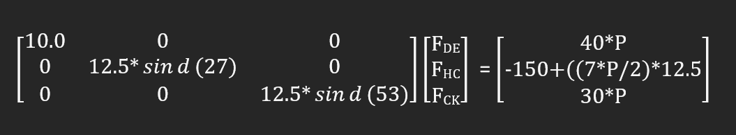
Creating Matrix from Linear Eq^{n} 1,2 and 3 to get 3 forces

Slide 9
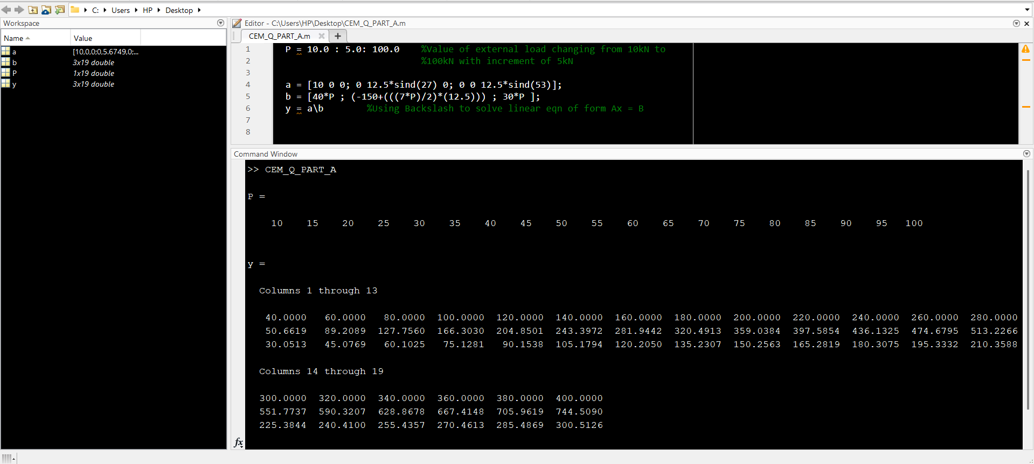
Solving Matrix using MATLAB Code METHOD-1 : USING BACKSLASH

Slide 10
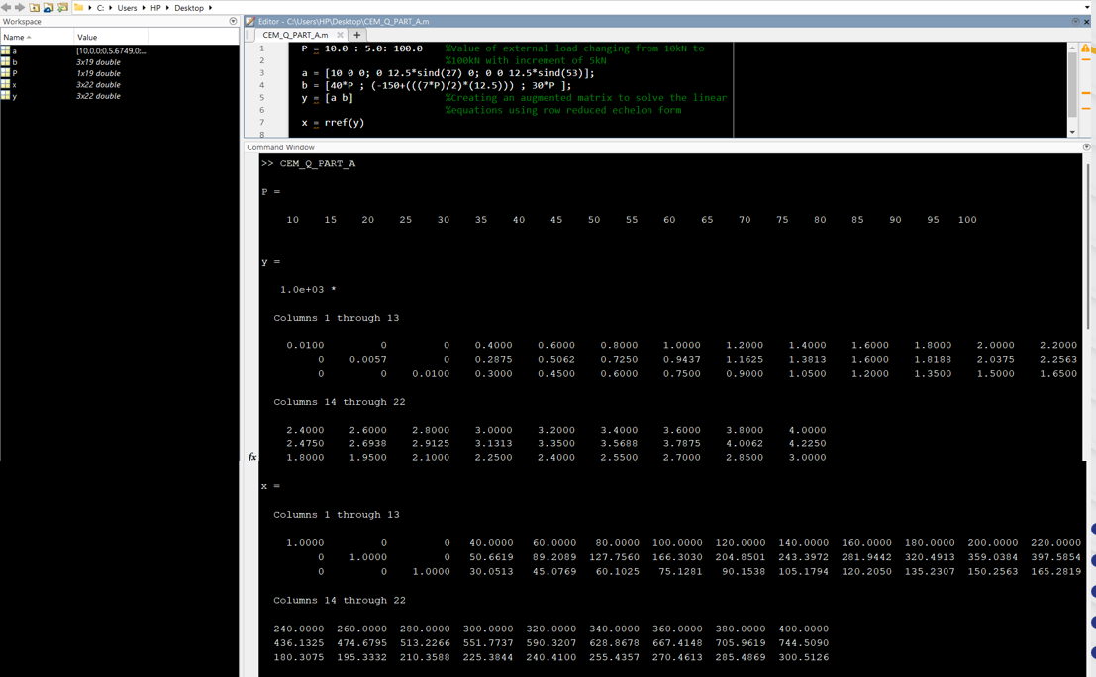
Solving Matrix using MATLAB Code METHOD-2 : USING RREF

Slide 11
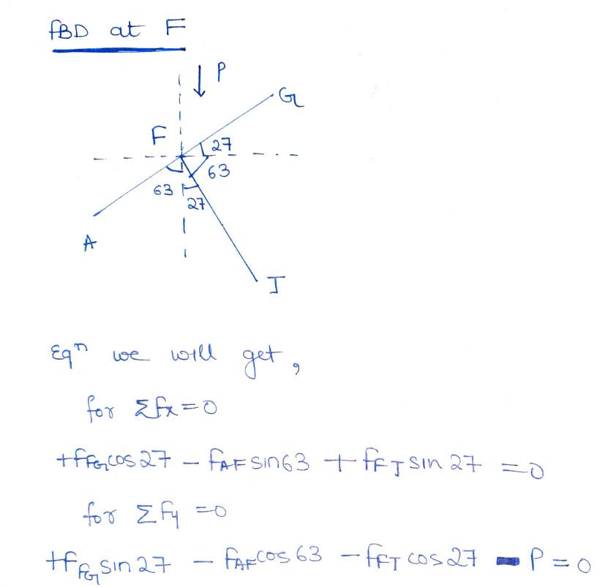
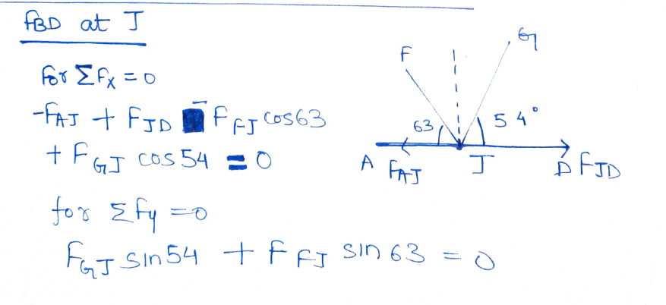
Creating FBD of each remaining point to get linear equations for other member forces
At Point F:
At Point J:

Slide 12
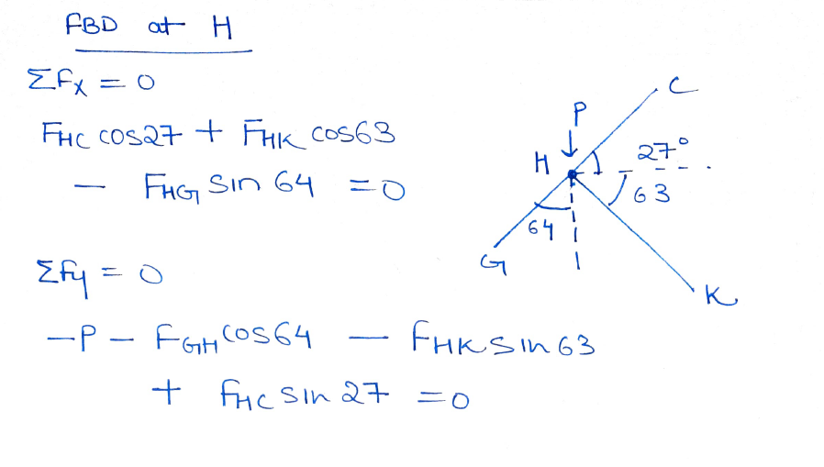
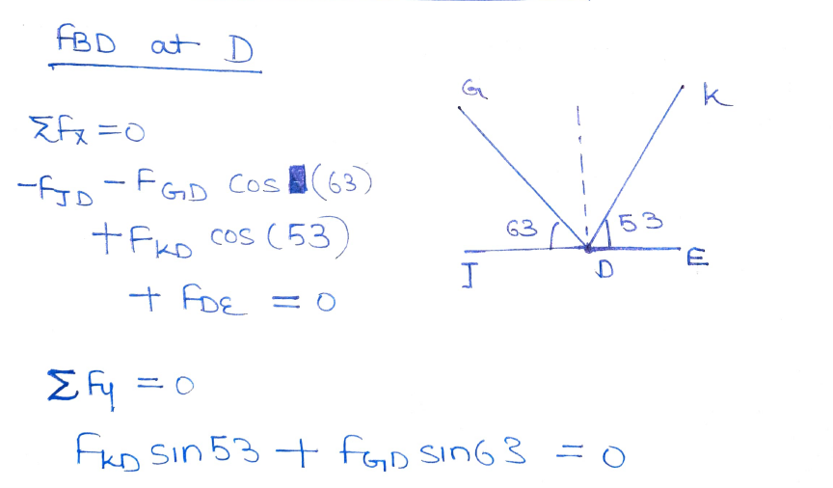
Creating FBD of each remaining point to get linear equations for other member forces
At Point H:
At Point D:

Slide 13
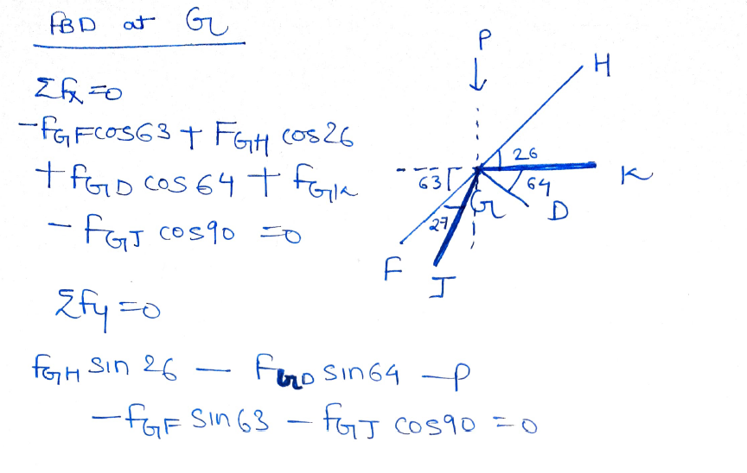
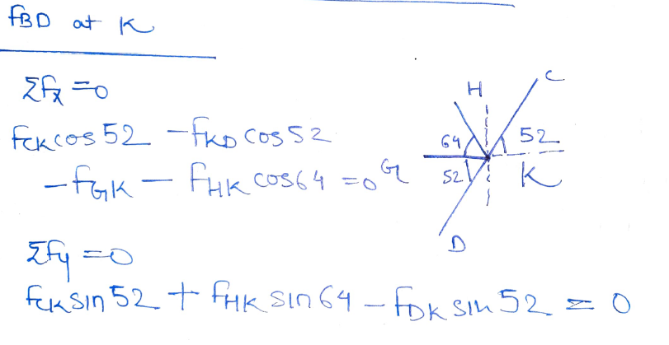
Creating FBD of each remaining point to get linear equations for other member forces
At Point K:
At Point G:
We now have linear equation for all the points. We have total of 12 Equations

Slide 14
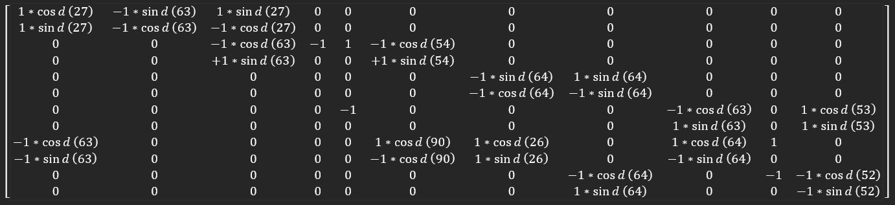
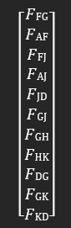
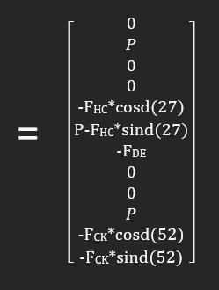
Creating Matrix from 12 Linear Eq^{n} to get member forces

Slide 15
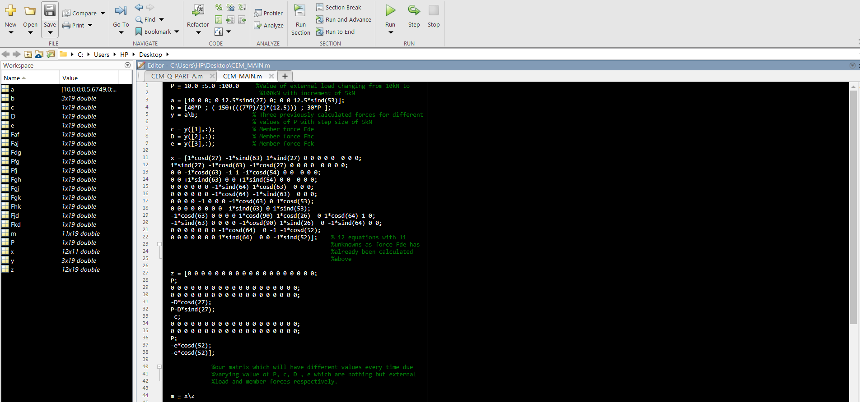
Solving Matrix using MATLAB Code METHOD-1 : USING BACKSLASH

Slide 16
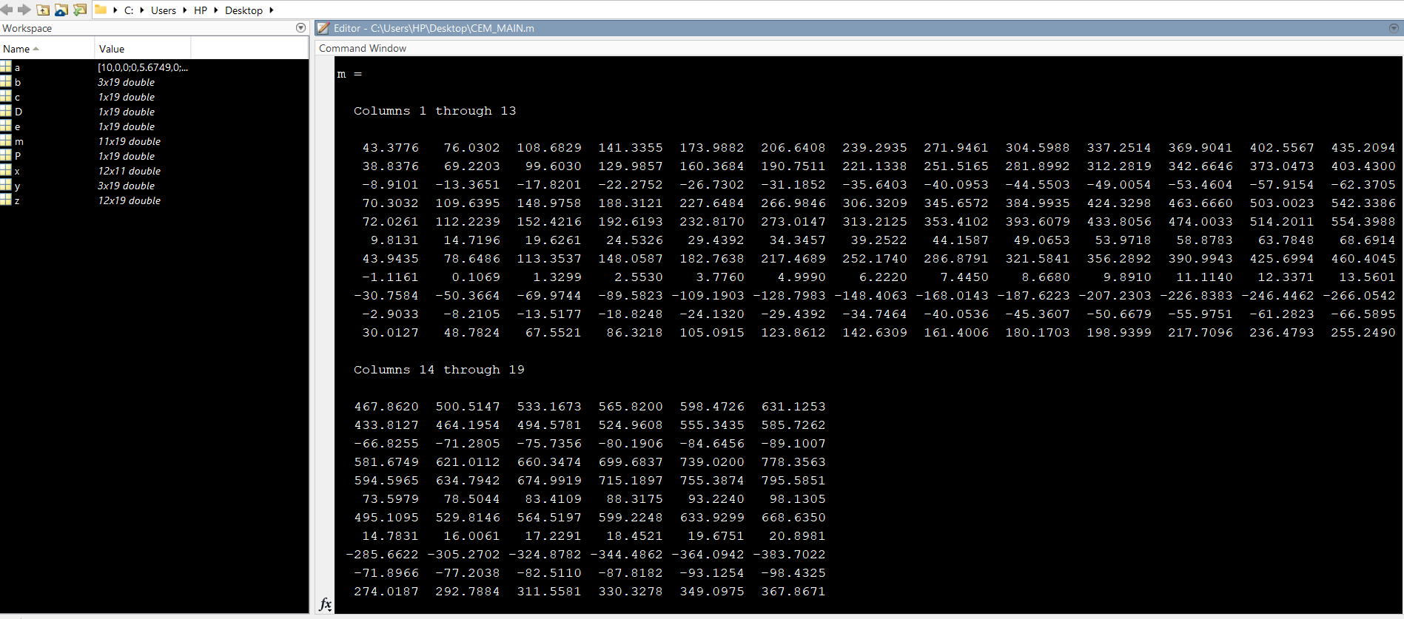
Output
Value of all the member forces for different values of P(external load)

Slide 17
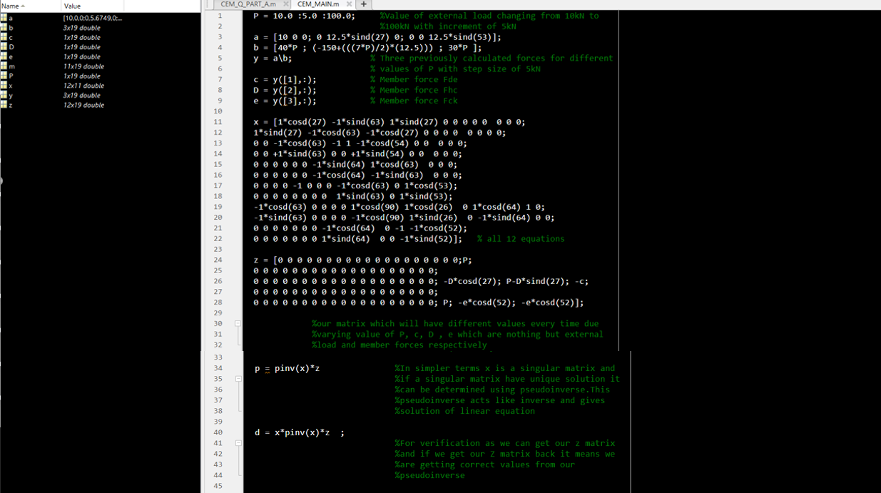
Solving Matrix using MATLAB Code METHOD-2 : USING PSEUDOINVERSE

Slide 18
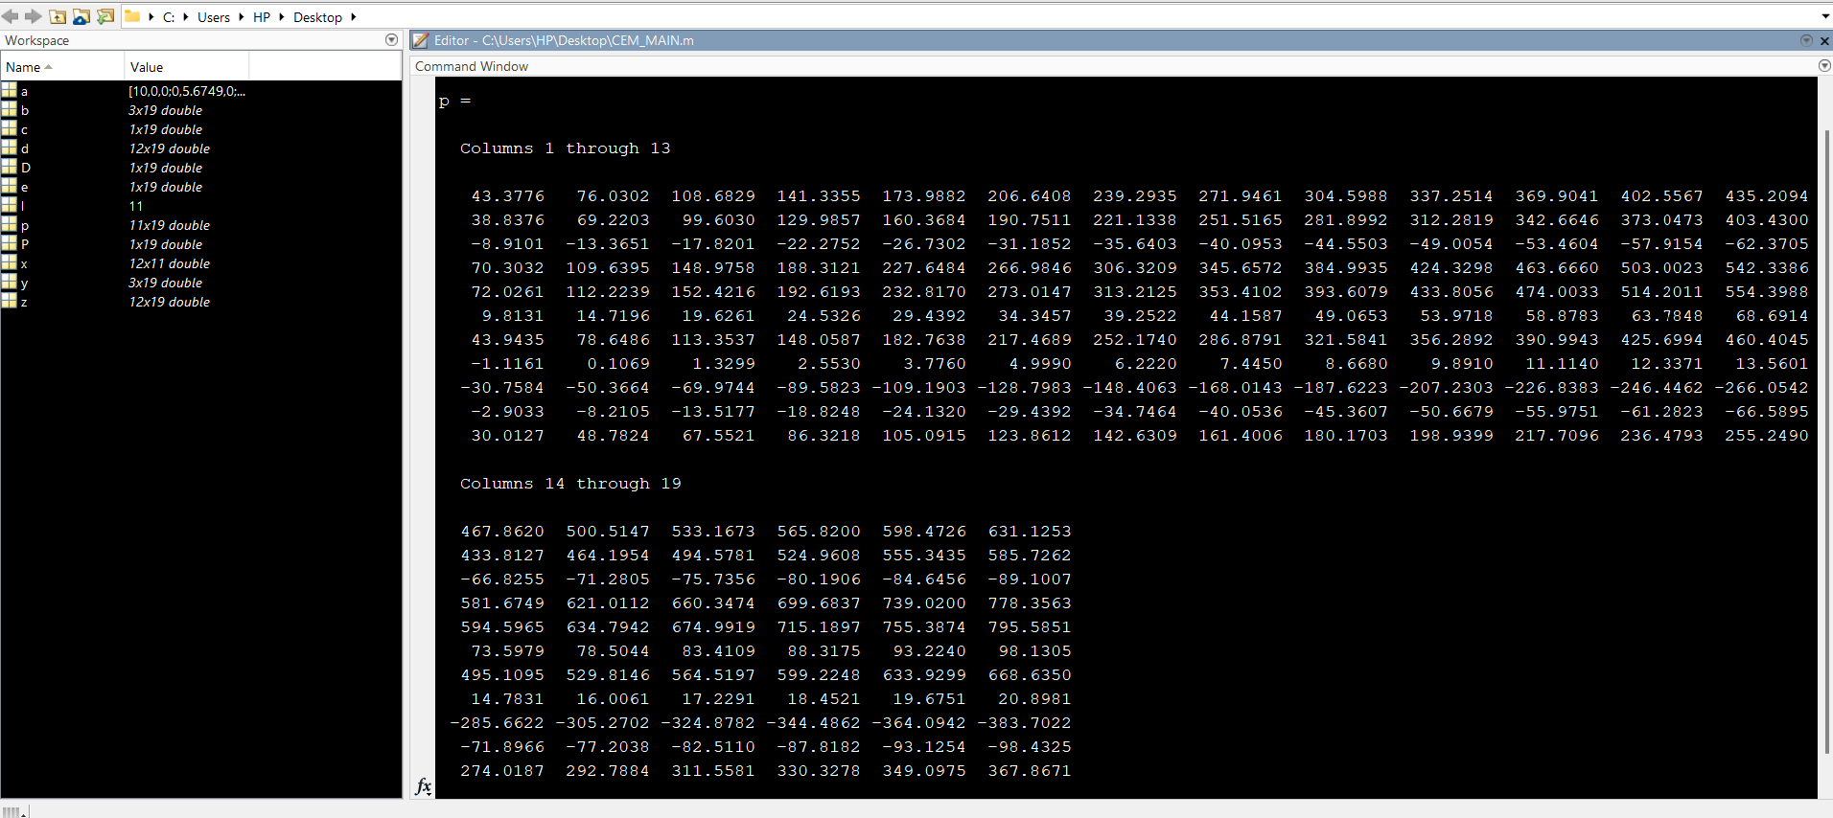
Output

Slide 19
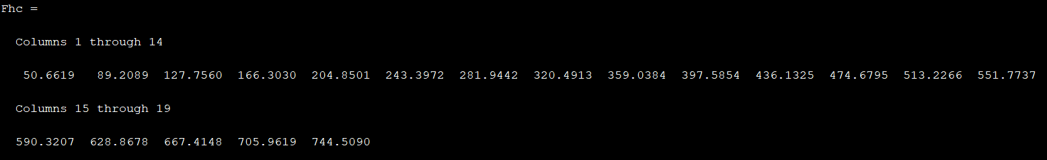
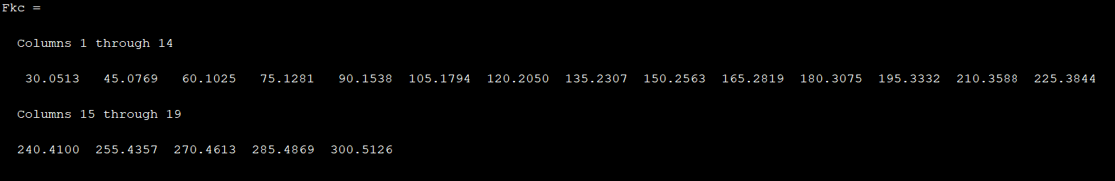
Value of Each member force for value of P varying from 10kN to 100kN with step size of 5kN

Slide 20
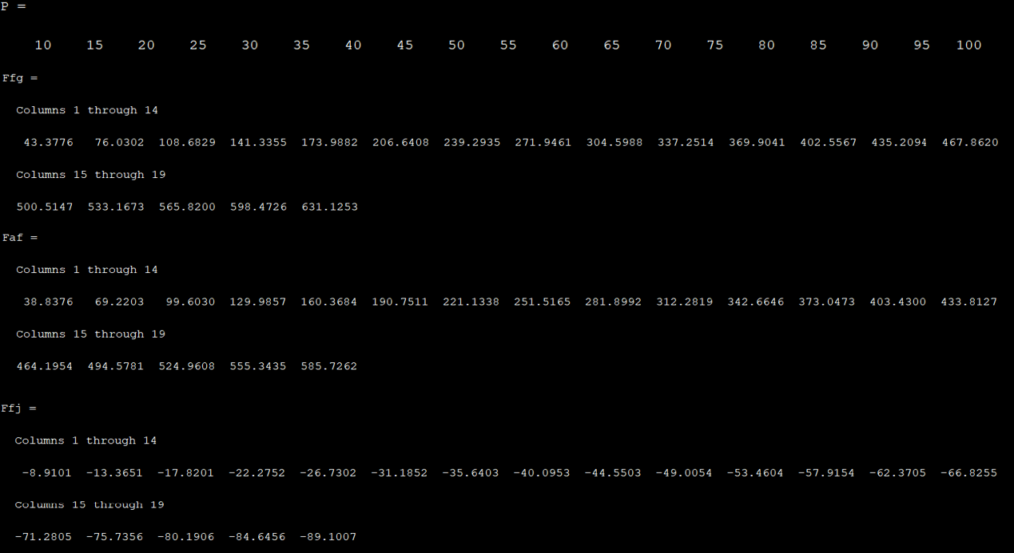
Value of Each member force for value of P varying from 10kN to 100kN with step size of 5kN

Slide 21
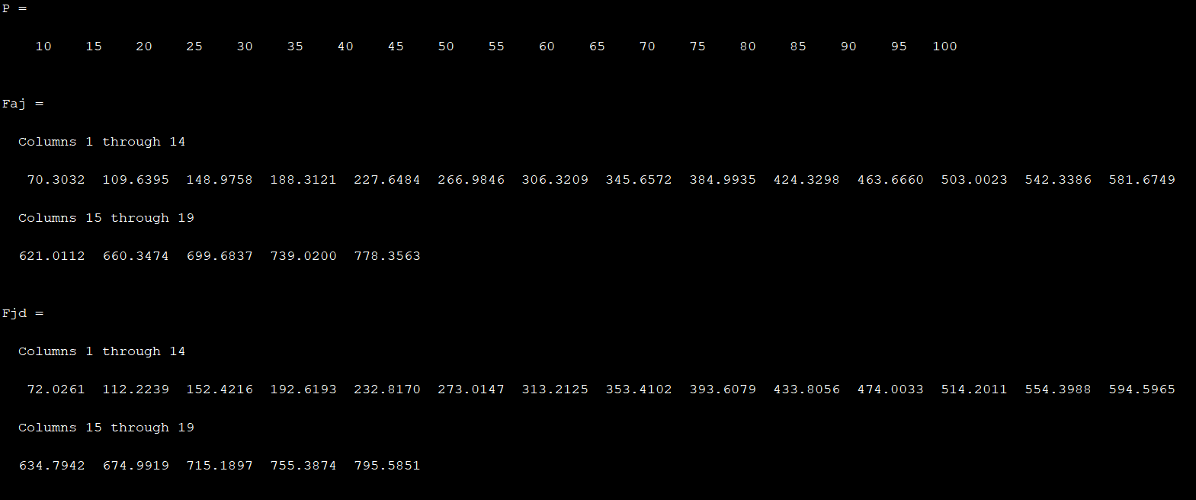
Value of Each member force for value of P varying from 10kN to 100kN with step size of 5kN

Slide 22
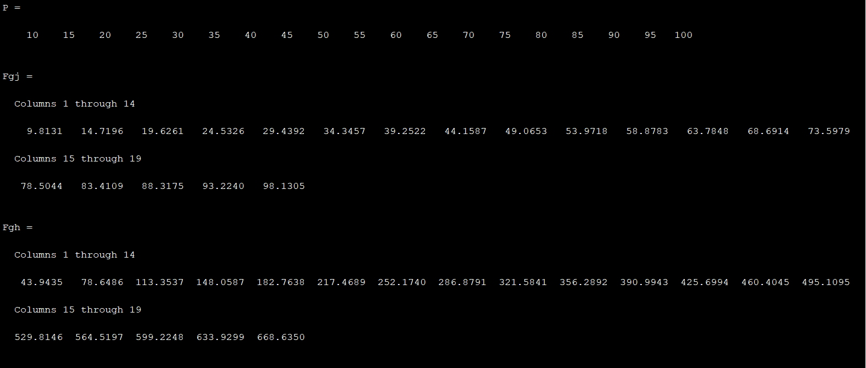
Value of Each member force for value of P varying from 10kN to 100kN with step size of 5kN

Slide 23
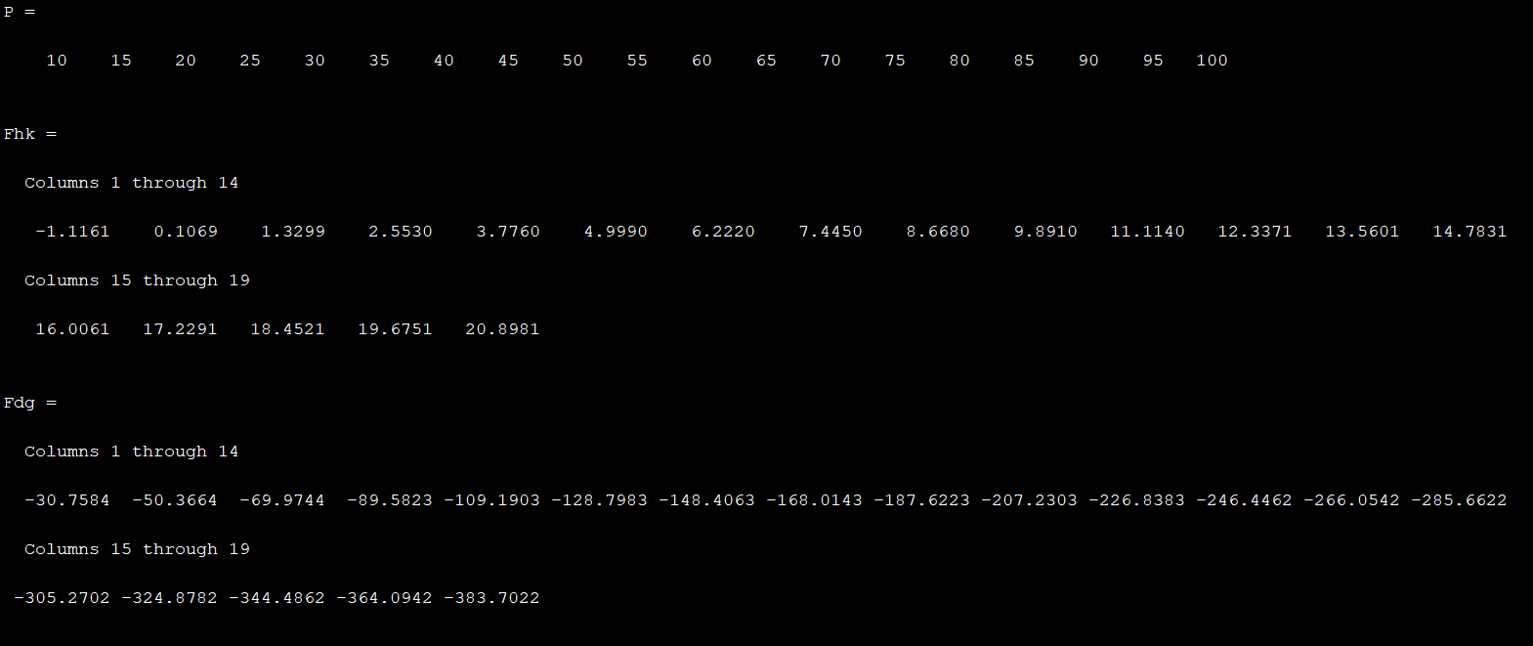
Value of Each member force for value of P varying from 10kN to 100kN with step size of 5kN

Slide 24
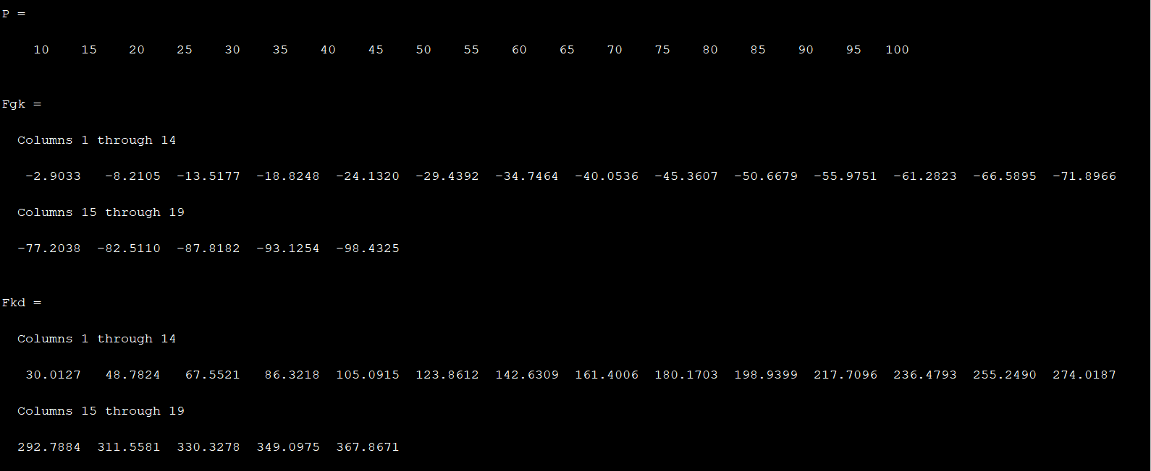
Value of Each member force for value of P varying from 10kN to 100kN with step size of 5kN

Slide 25
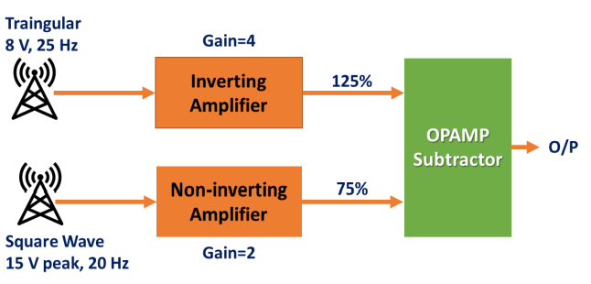
02
Create MATLAB code to mimic the operating
concept of the OPAMP-based system given
below.
• MATLAB codes should estimate the
instantaneous voltage values at all the
stages.
• If the final output is applied to an
inductor, demonstrate the variation in
the energy stored in it. Choose a suitable
numerical approach

Slide 26
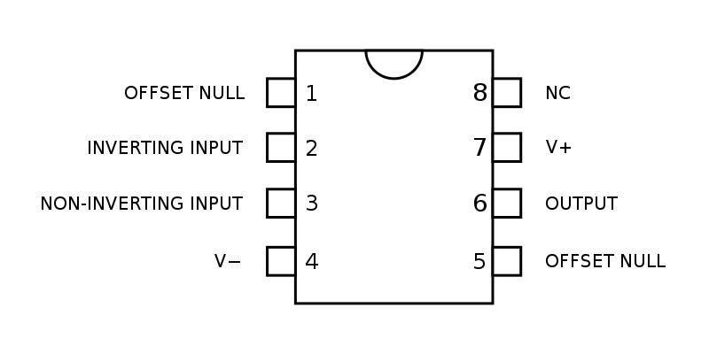
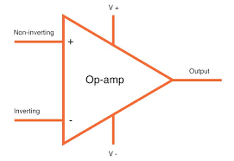

Slide 27
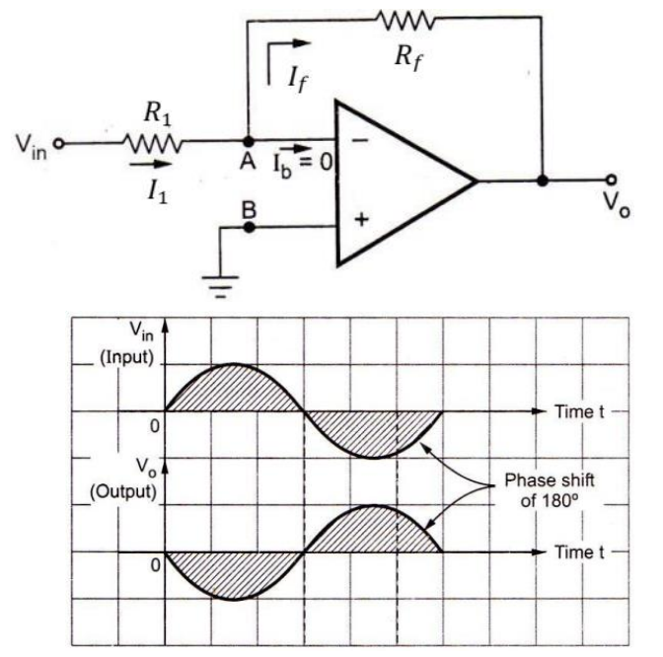
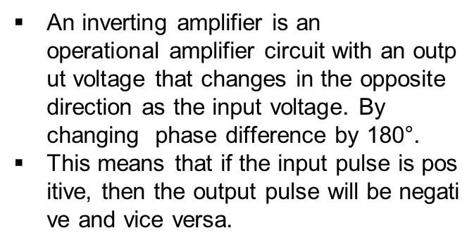
Inverting Amplifier

Slide 28
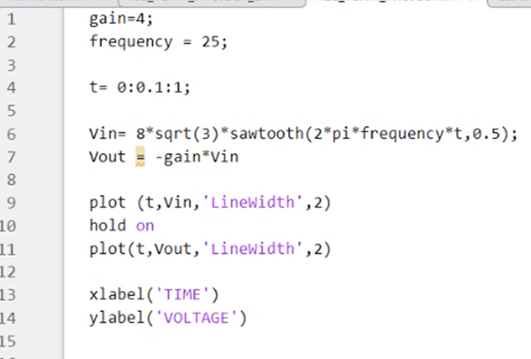
MATLAB CODE

Slide 29
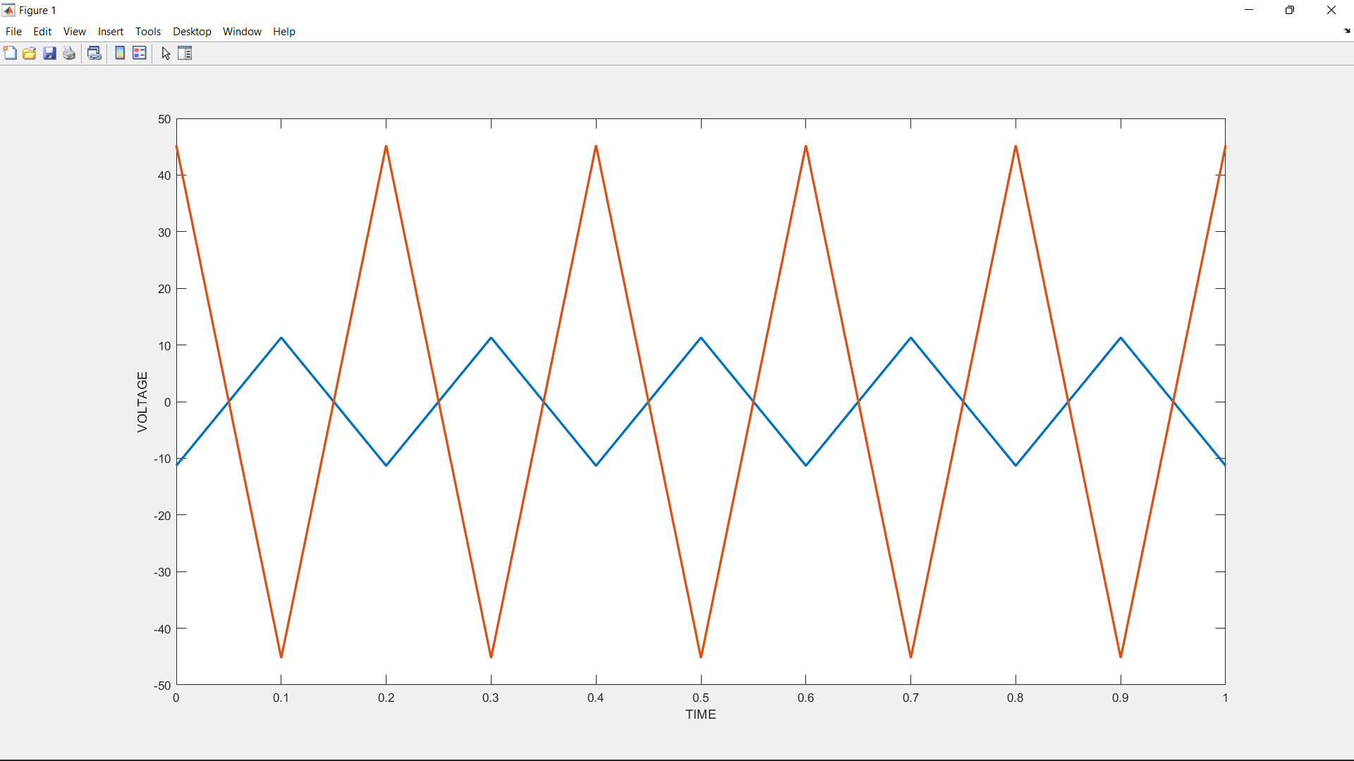
OUTPUT

Slide 30
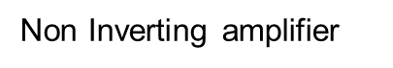
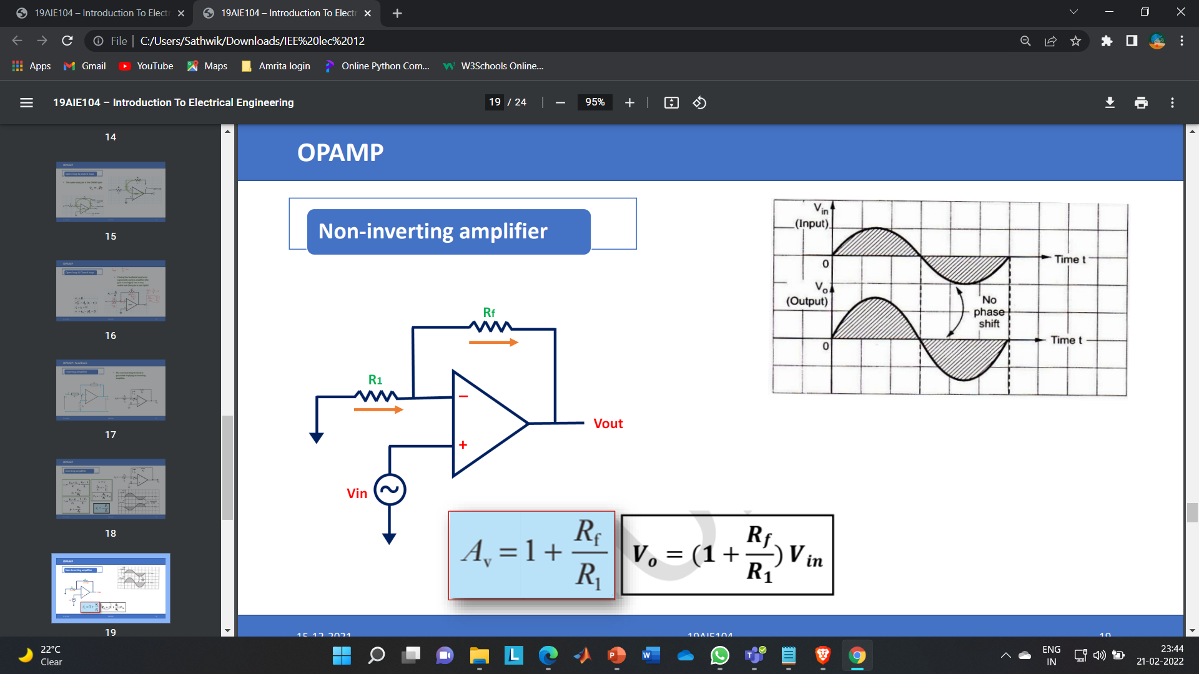
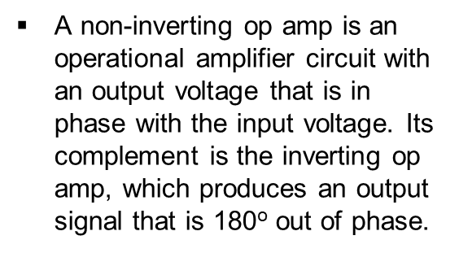
Gain

Slide 31
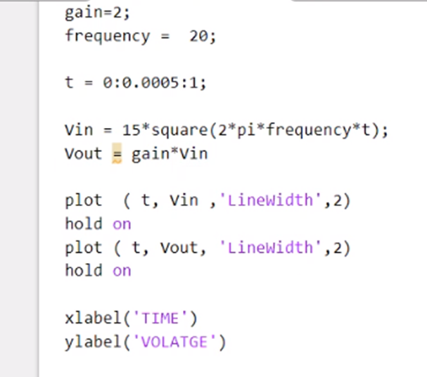
MATLAB CODE

Slide 32
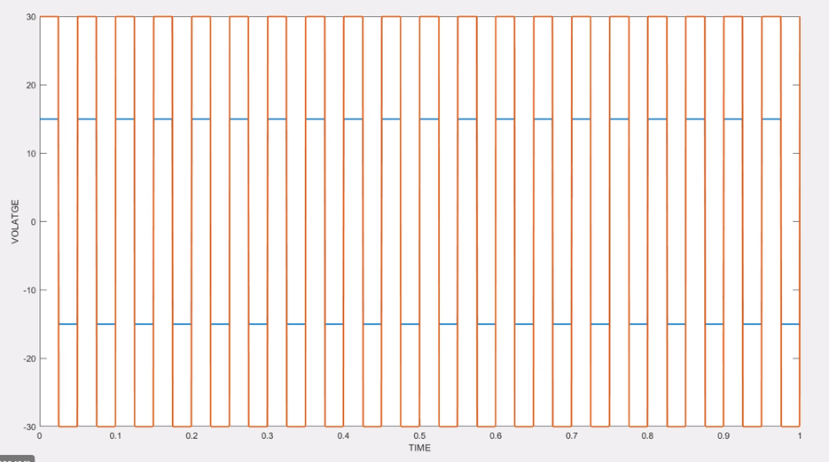
OUTPUT

Slide 33
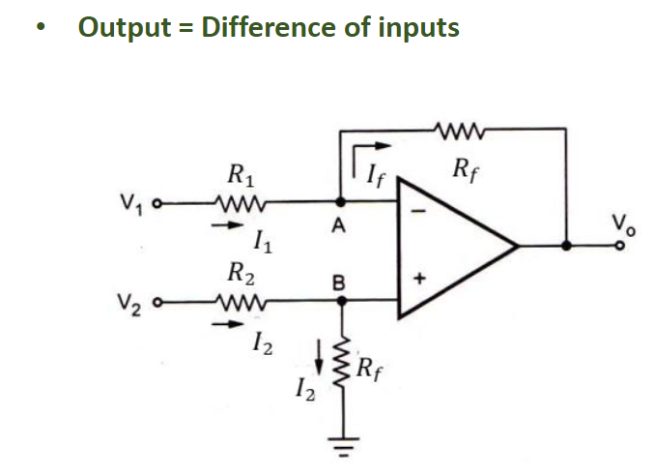
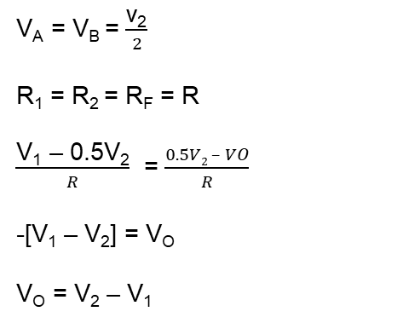
OPAMP SUBTRACTOR
The subtraction of the two input voltages is possible with the help of a subtractor. The subtractor using op-amp is shown in the figure. It is also called a difference amplifier.
V_{A} = V_{B} = $\frac{\text{v}\text{2}}{2}$
R₁ = R₂ = R_{F} = R
$\frac{\text{V}\text{1}\text{ – 0.5}\text{V}\text{2}}{R}$ = $\frac{0.5V2 – VO}{R}$
-[V₁ – V₂] = V_{O}
V_{O} = V₂ – V₁

Slide 34
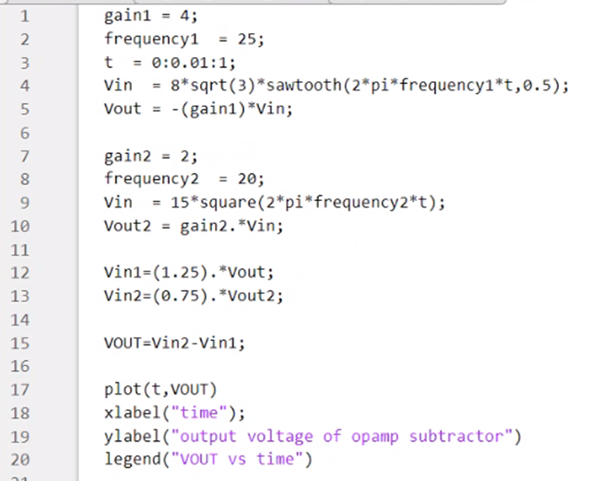
MATLAB CODE

Slide 35
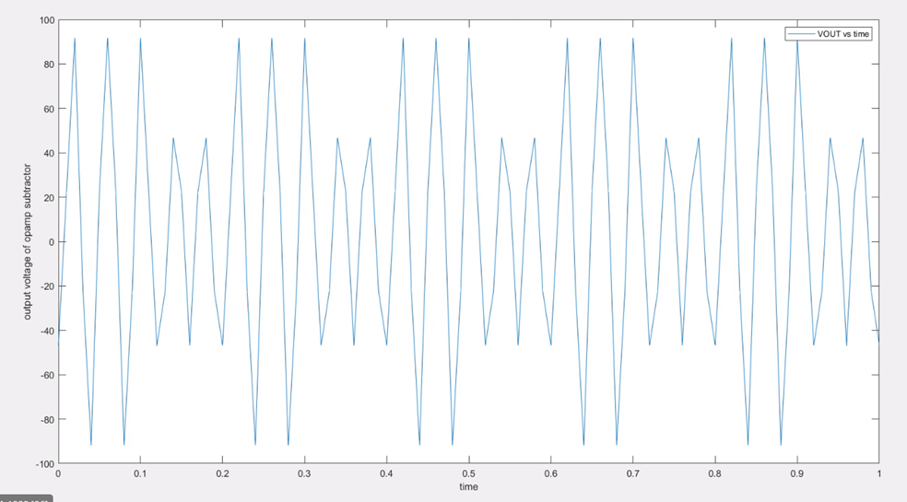
OUTPUT

Slide 36
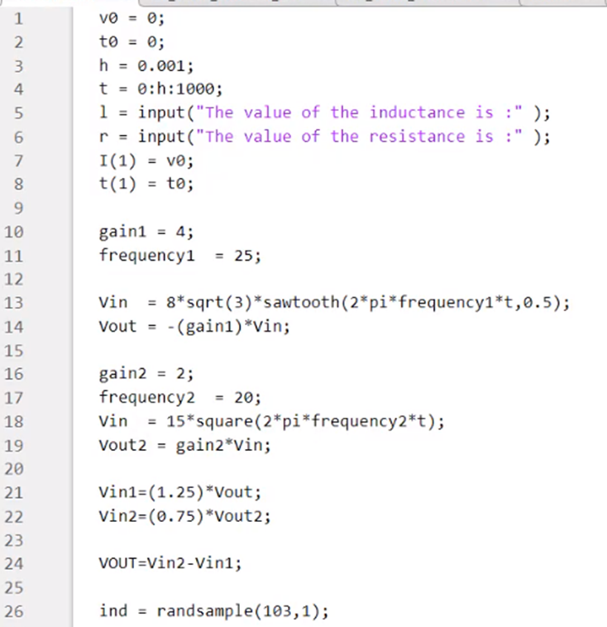
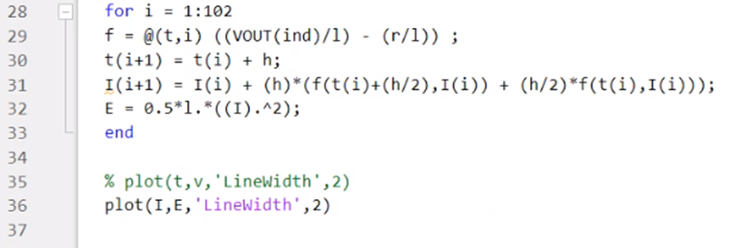
NUMERICAL CODE

Slide 37
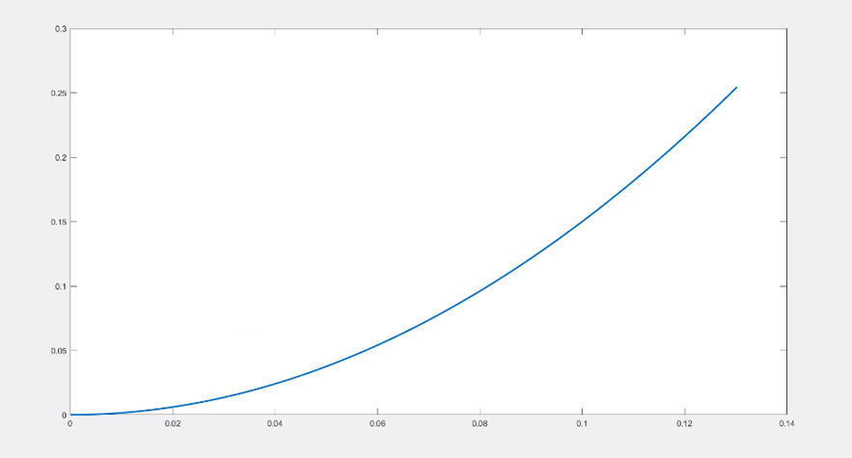
OUTPUT

Slide 38
THANKS

